Slide 1
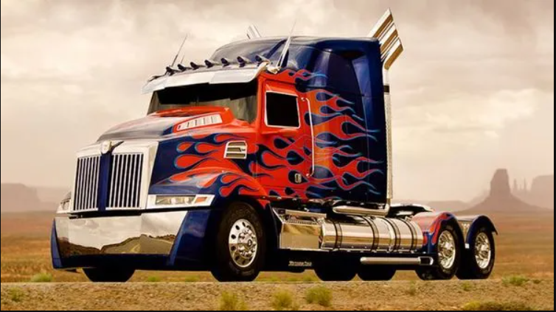

ANT Truck Business Analysis
MIS 6346, Fall 2022
Group 7
Group Members
Darsh Pancholi
Saranya Viveka Moorthy
Sai Srinivas Penumaka
Group 7

Slide 2
INTRODUCTION
In the past ten years, the trucking business has experienced remarkable expansion due to the rise in demand for moving commodities between cities and states.
During COVID, the demand increased significantly. There are anticipated to be, on average, 259,900 openings for heavy and tractor-trailer truck drivers over the next ten years.
Creating a safer environment for truck drivers is of utmost importance as the number of accidents and deaths related to the industry have increased significantly and are projected to increase annually
Group 7

Slide 3
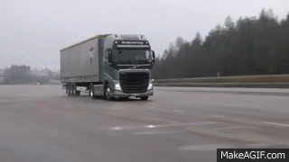
BUSINESS OBJECTIVES
Identifying the primary risk factors in the trucking industry to lessen major accidents and to prevent loss of life and money
To analyze the dataset based on various factors like geographic location, events, models, miles and risk factor
To ensure that drivers comply with company’s rules and regulations so as to minimize the risks
Group 7

Slide 4







PROCESS WORKFLOW
Download Dataset to local machine
Load the Data into Cloudera VM
Move the files from local directory into HDFS
Import data into Hive
ODBC Connector
Analyze and Visualize Data to gain insights
Populated the risk-factor table
Group 7

Slide 5
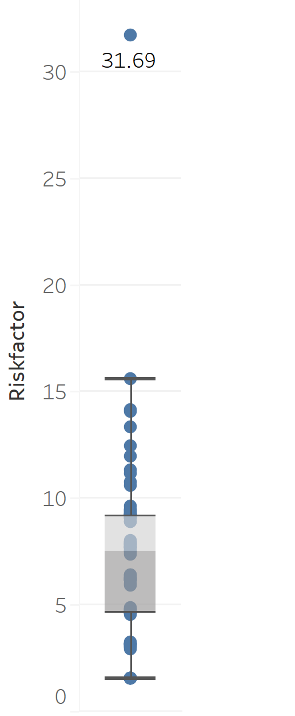
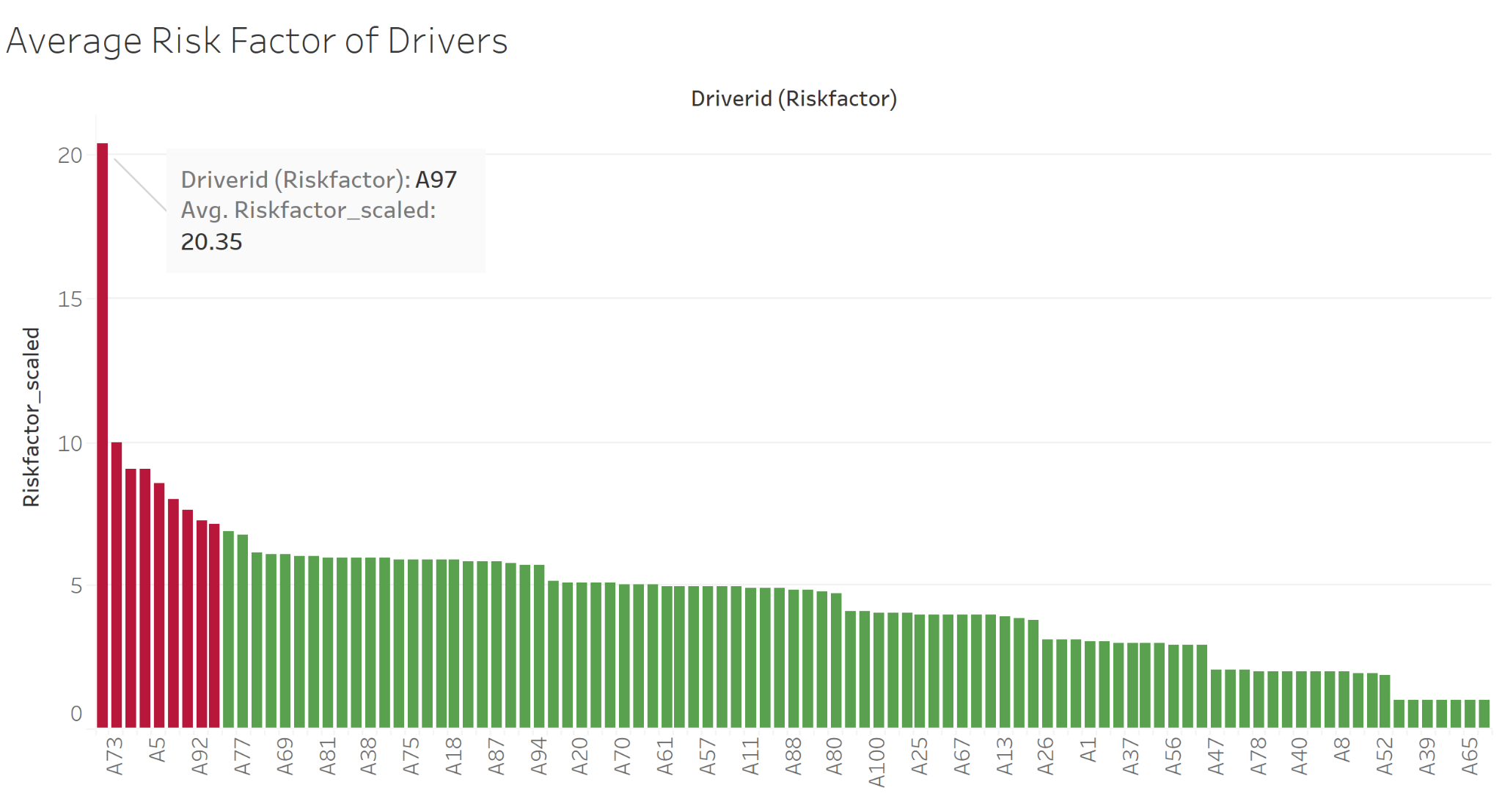
UNDERSTANDING THE DATASET
ScaledRiskfactor =
([Riskfactor]/15.5709*10
Group 7

Slide 6
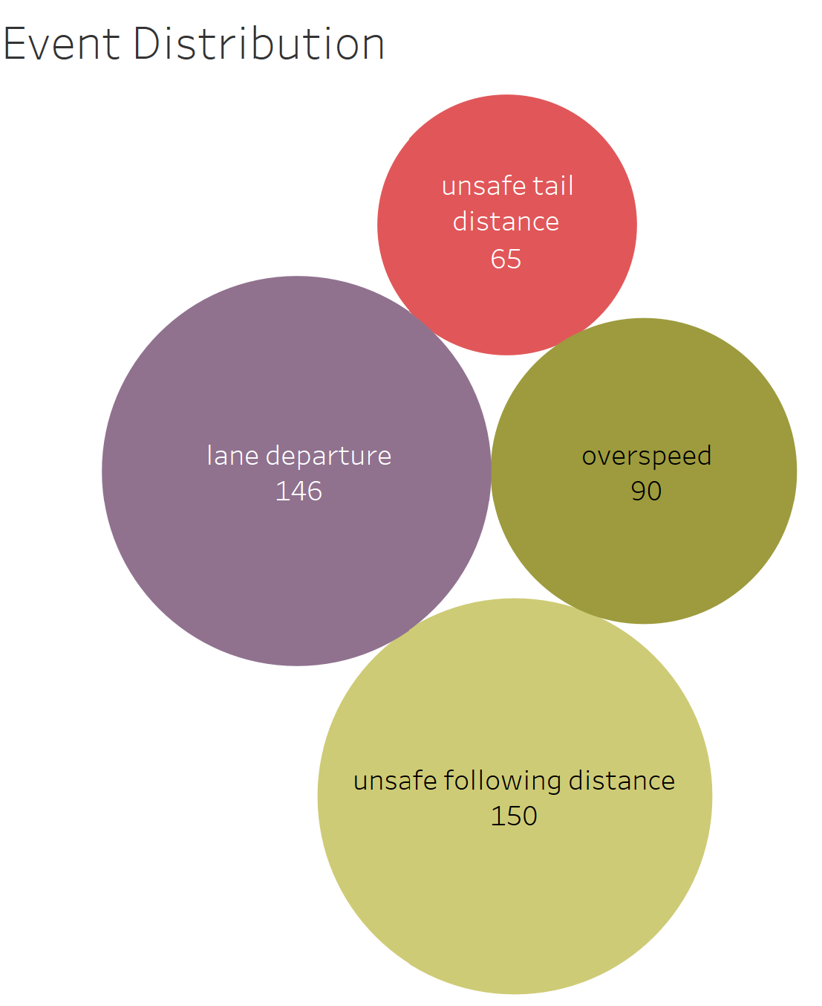
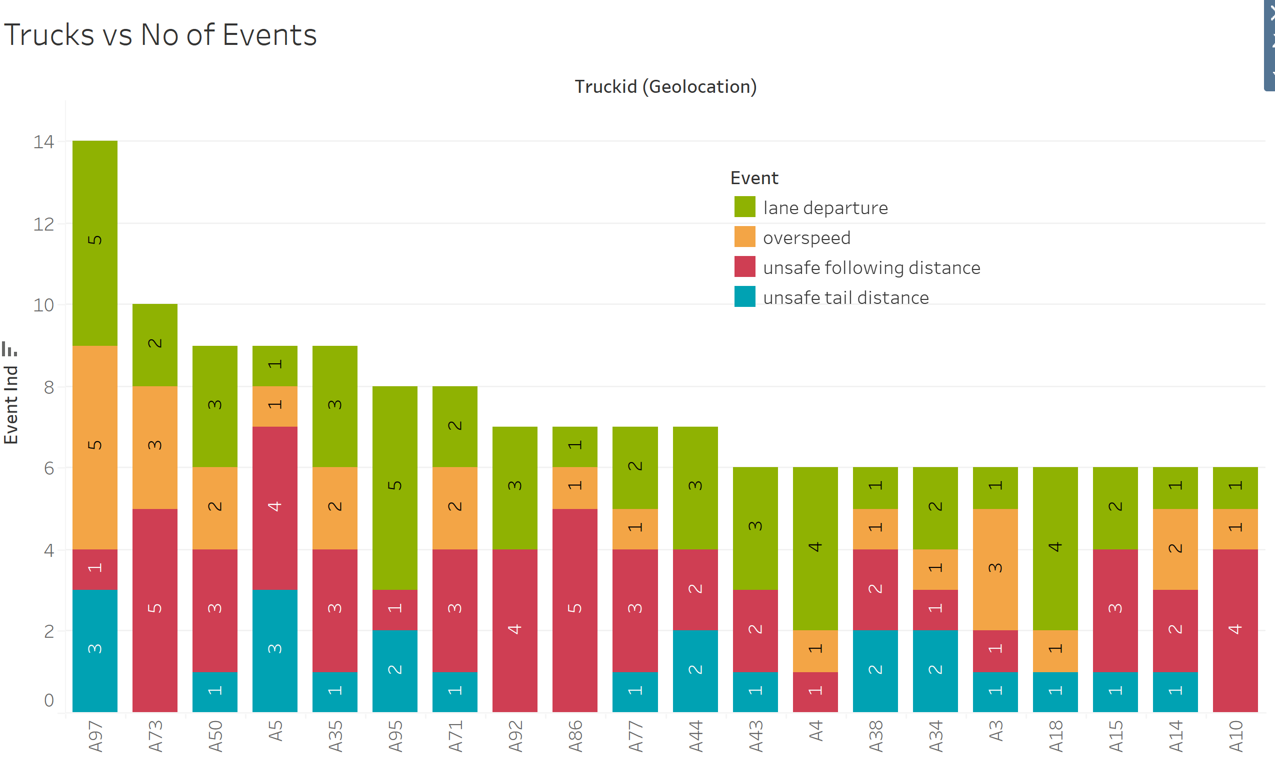
EVENT ANALYSIS
As per the bubble graph, unsafe following distance and lane departure are the highest causes of the incidents.
Of all the trucks, A97 and A73 are riskiest trucks with most incidents.
Also most lane departures are found in A97, A95, and A4. & most unsafe following distance is observed in A73 and A86.
Group 7

Slide 7
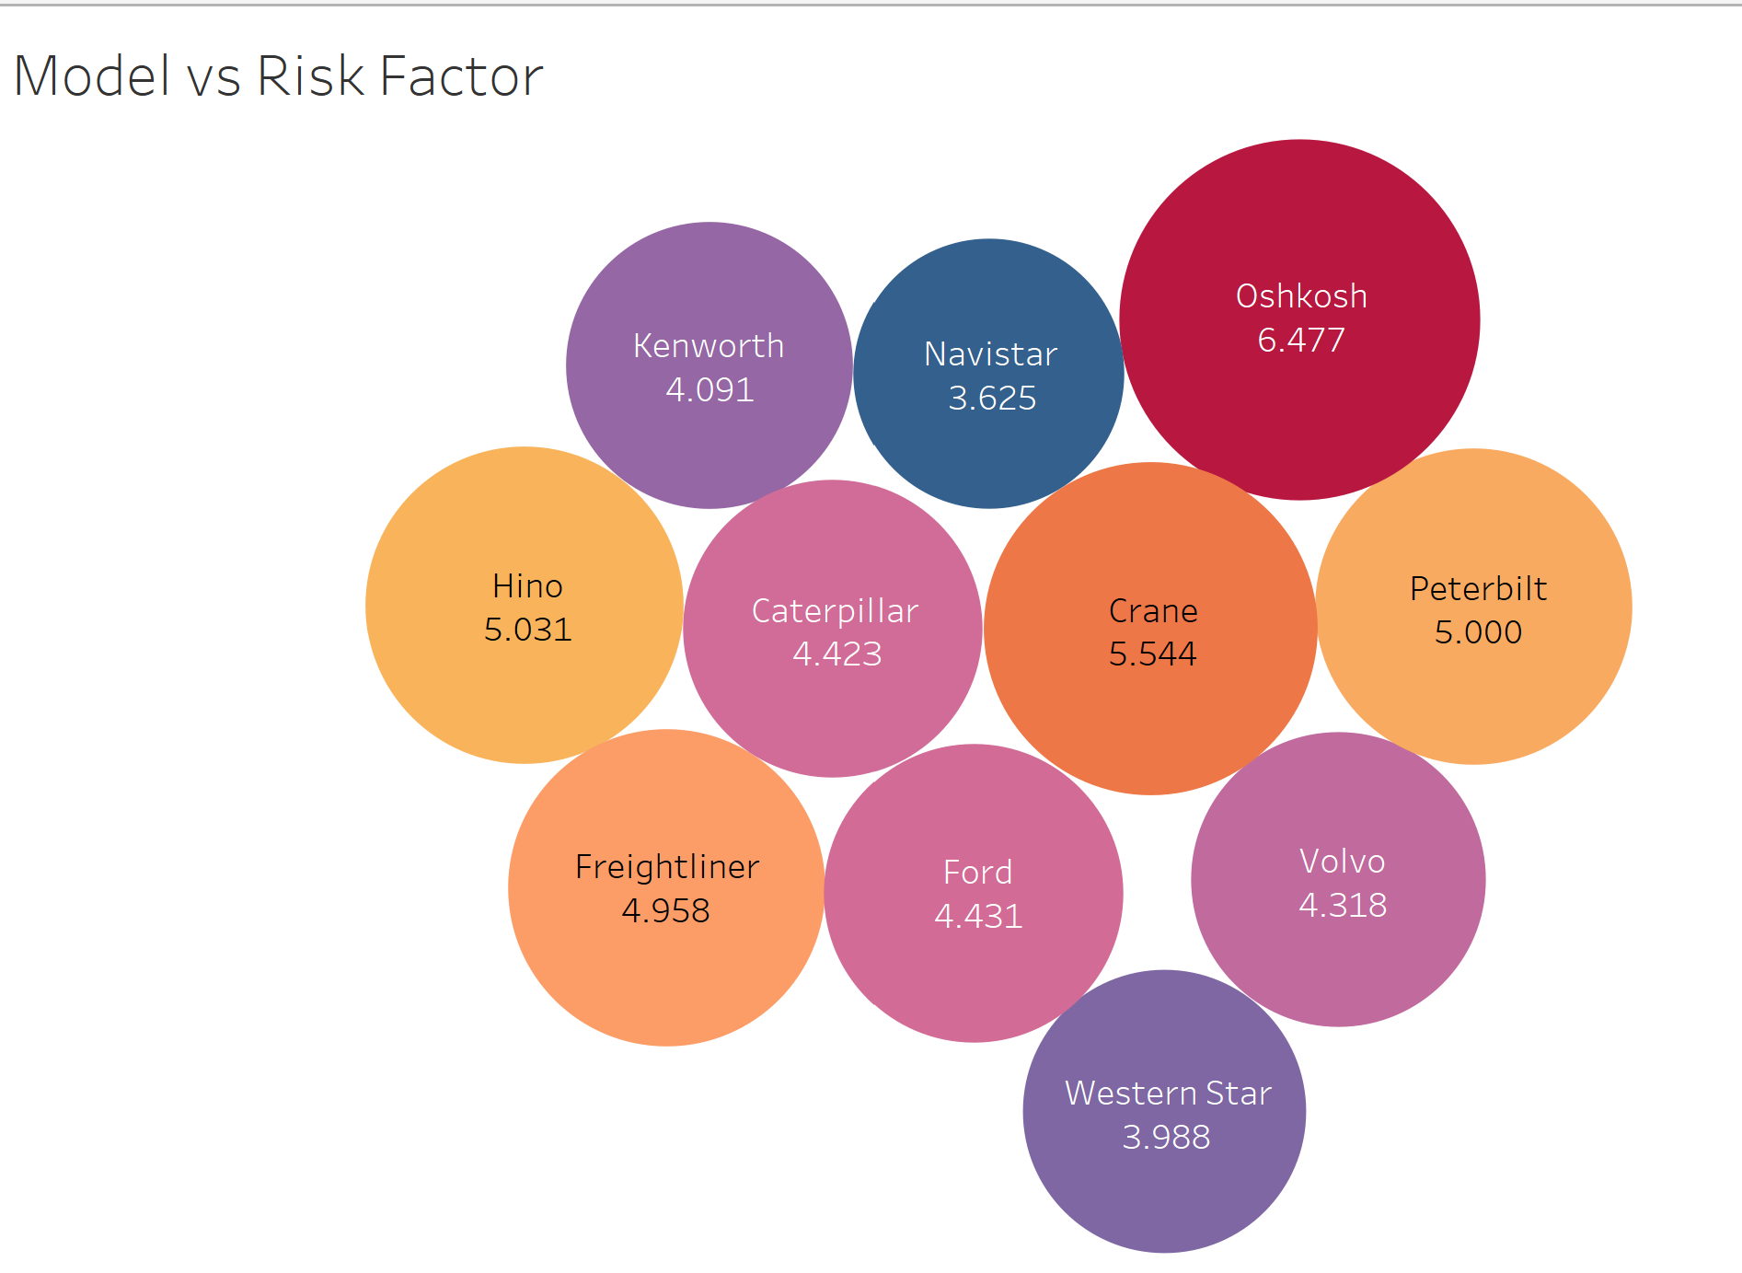
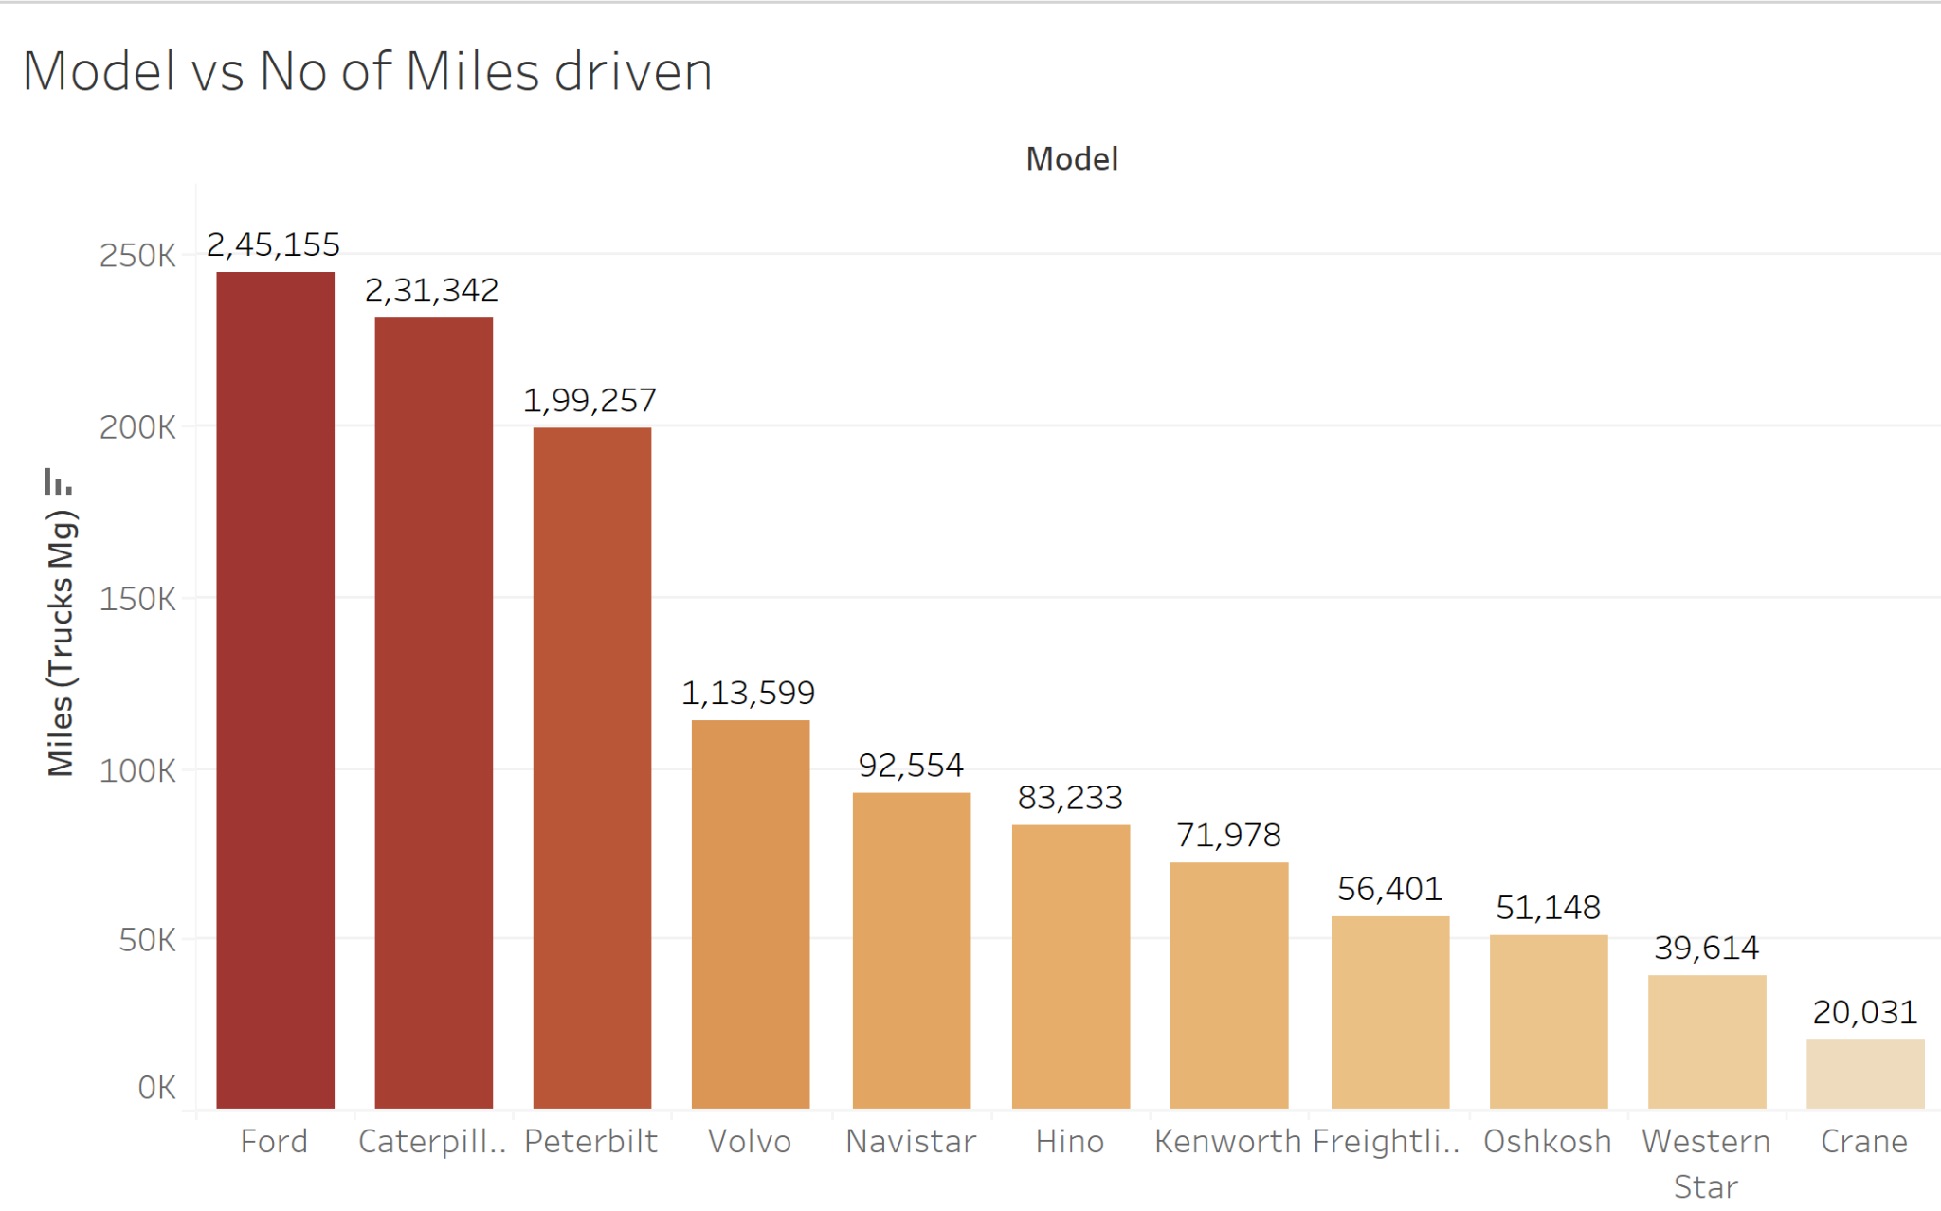
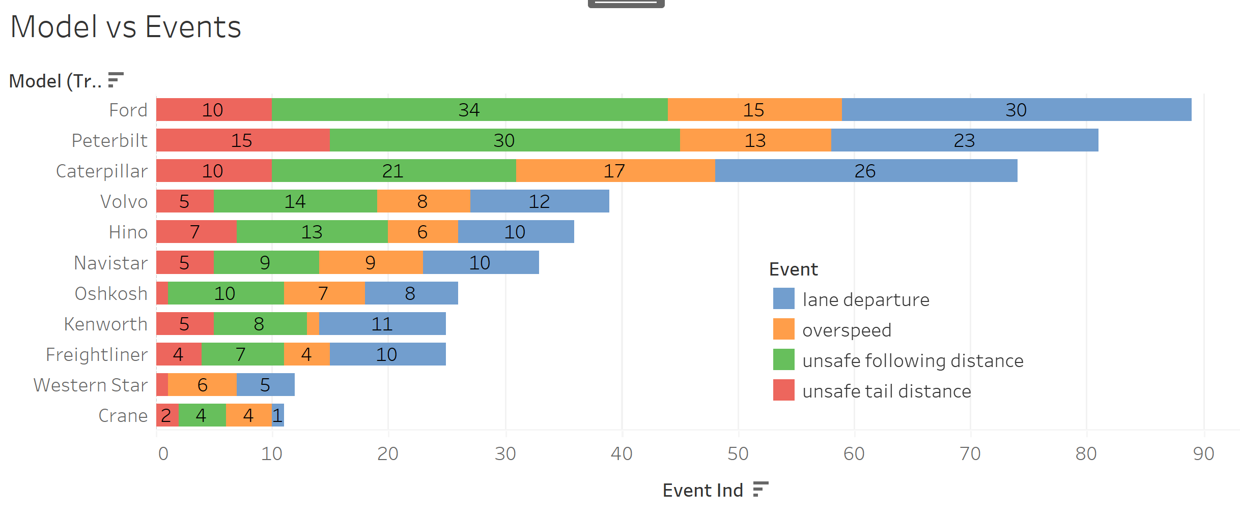

MODEL- WISE ANALYSIS
Ford is the most popular truck brand followed by Caterpillar, Peterbit and others by no. of miles driven.
No. of events is directly correlated to the number of miles driven.
The safest truck model is Navistar while the riskiest is Oshkosh. All the models are in compliance with the risk scale of below 7.0
Group 7

Slide 8
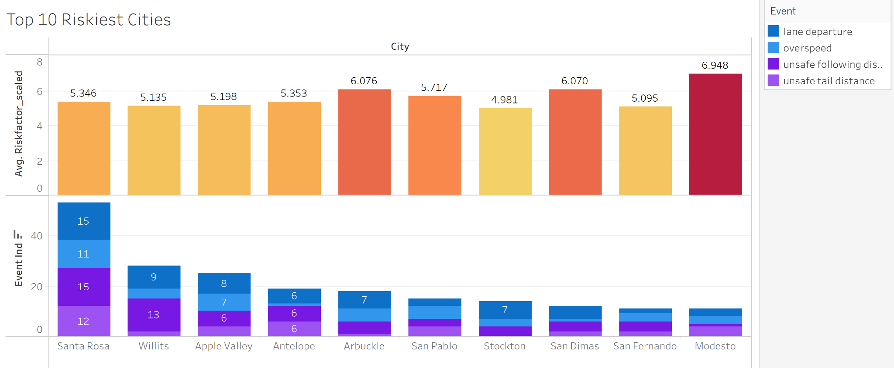
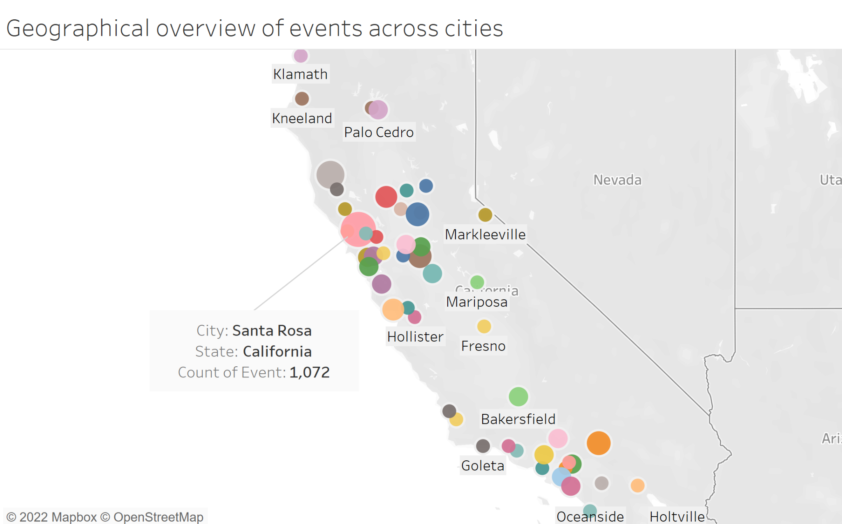
CITY-WISE ANALYSIS
Based on the number of events we see that Santa Rosa is the city with most number of Events which were 53.
Contrary to the belief that the number of events will be directly proportional to the Average Risk factor, we observe that the case is different.
Santa Rosa, despite having most number of events, does not show the same pattern in the Average Risk factor meanwhile, on the other hand, Modesto, having the least number of events shows the highest Average Risk Factor.
Group 7

Slide 9
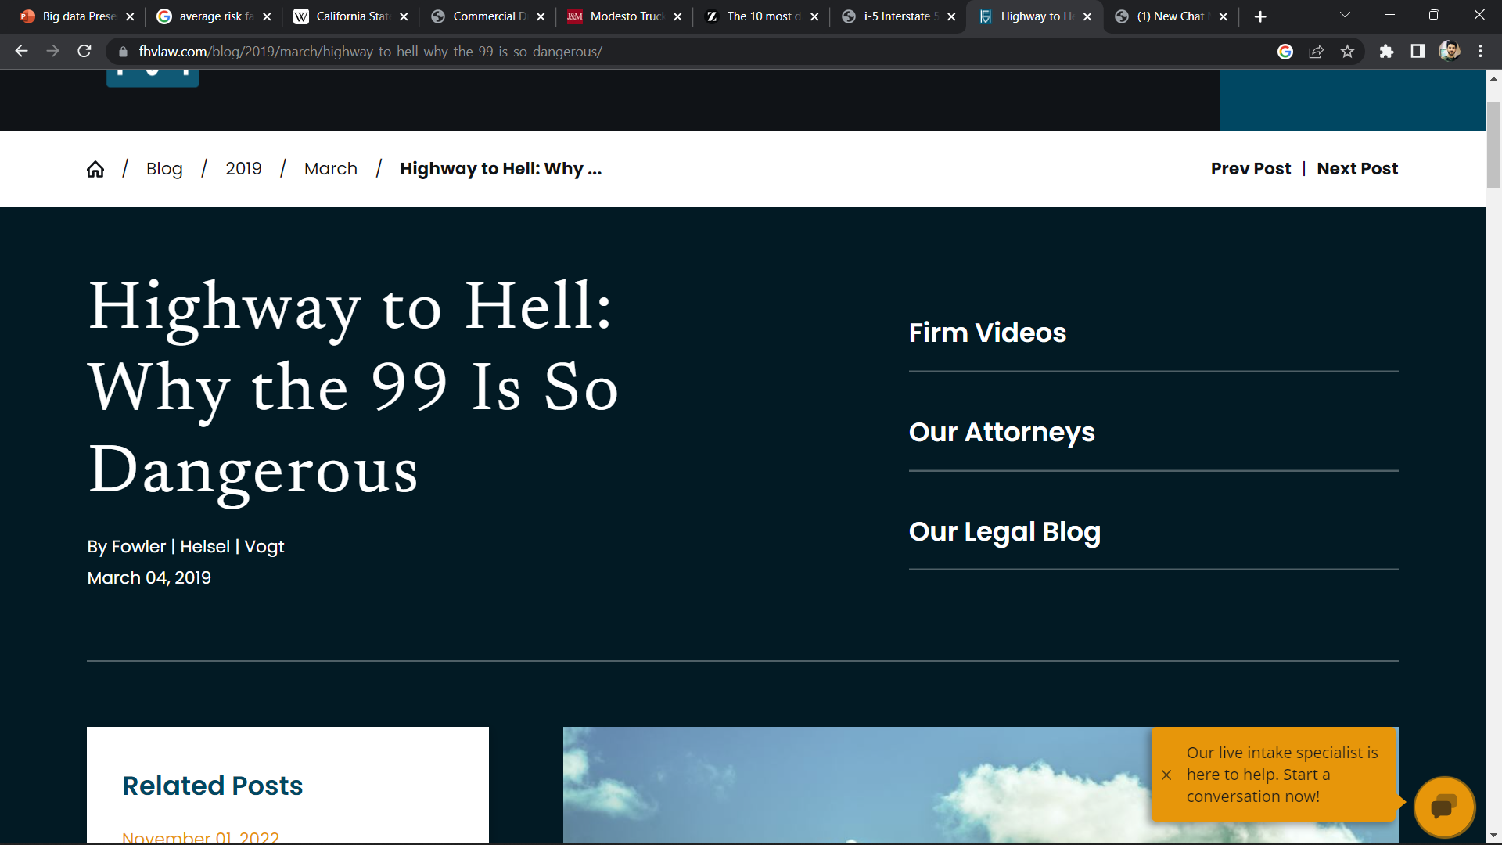
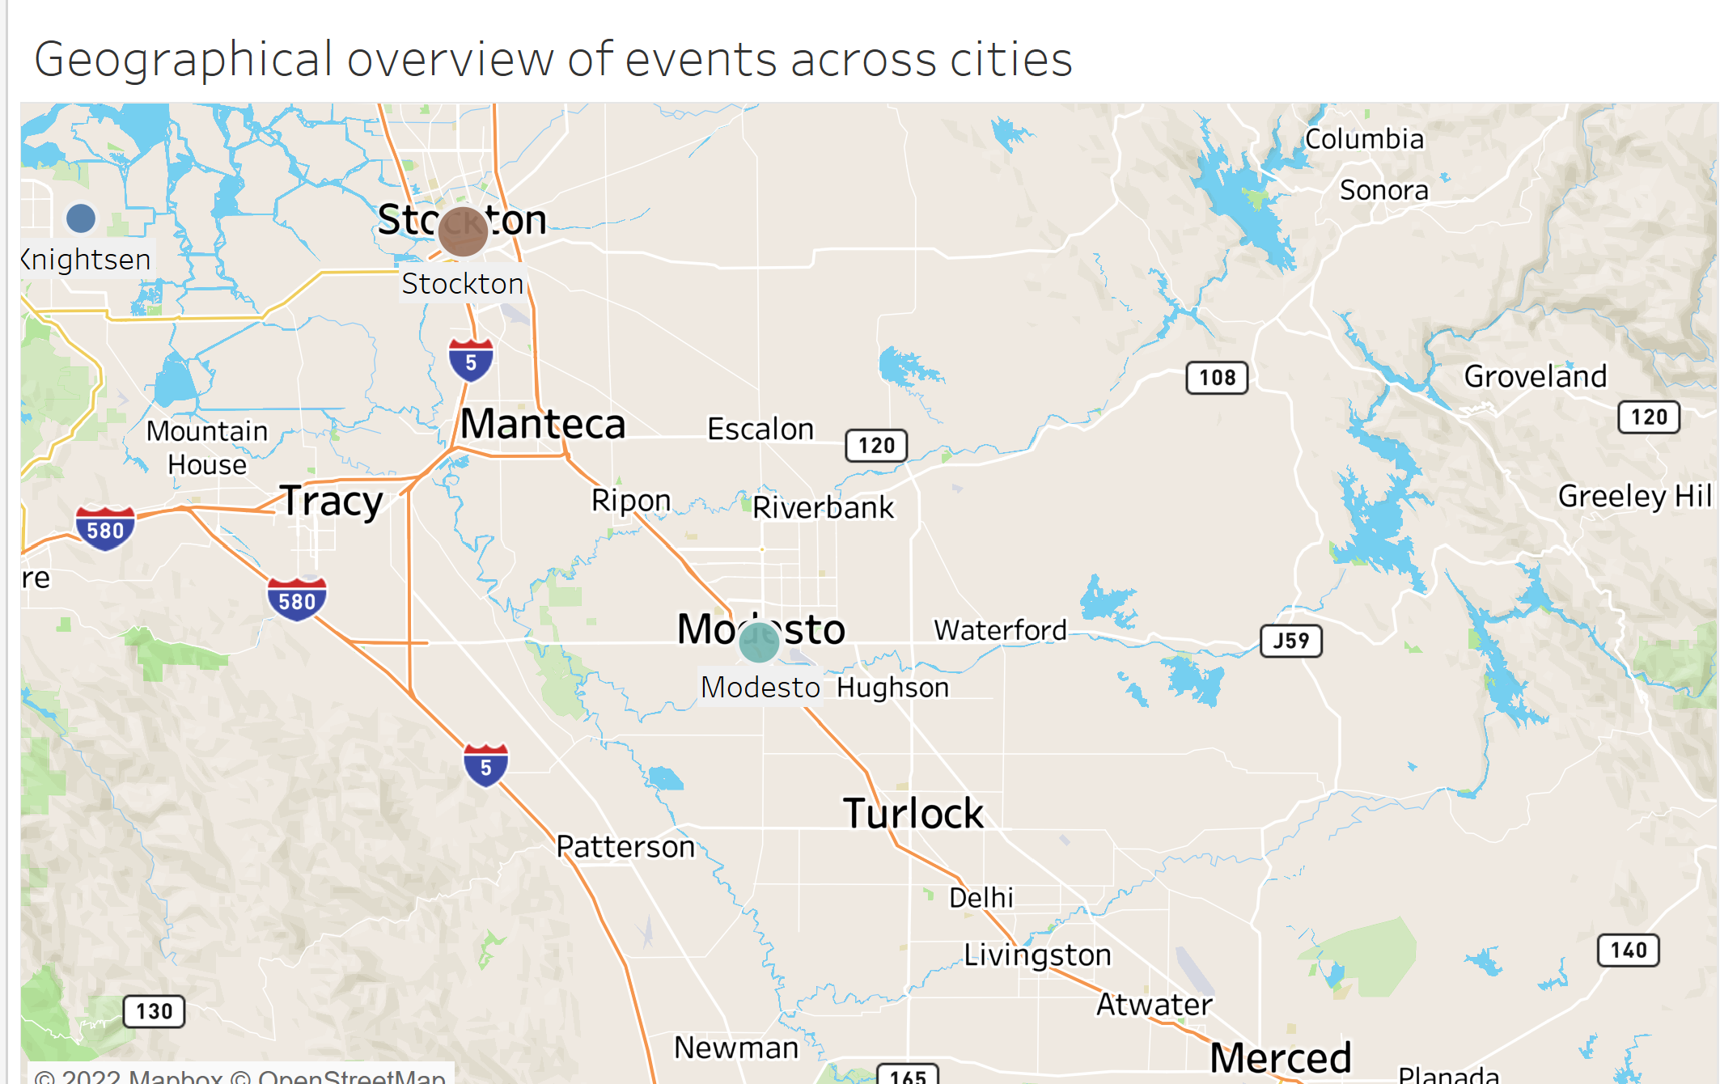
Along Highway 99, about 25.5 accidents per 100 miles happen in darkness without lighting. In the last five years, 40% of all fatal accidents on the roadway have happened in the dark without sufficient lighting.
Highway 99 is narrow and aging. This makes it less safe for motorists than more modern roadways.

Slide 10
DRIVER WISE ANALYSIS
This visual representation would help us analyze the drivers with the highest risk factors and to help avoid accidents
Driver with the id A97 has the highest risk-factor of 20.35
After driver ID A97, the following drivers are crossing the 7.0 threshold: A73, A50, A5, A92, and A35.
Group 7

Slide 11
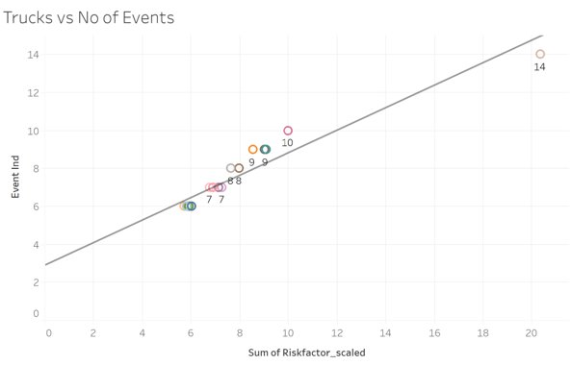
REGRESSION ANALYSIS
R-SQUARED=0.9166
P-VALUE<0.0001
Group 7

Slide 12
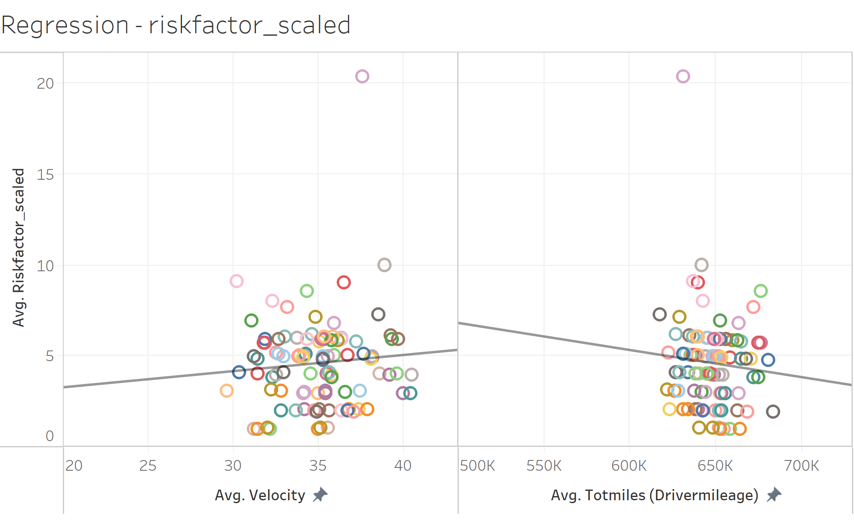
REGRESSION ANALYSIS
R-SQUARED=0.00757
P-VALUE=0.39173
R-SQUARED=0.00714
P-VALUE=0.405
Group 7

Slide 13
CONCLUSION
Based On The Offenses Committed By Drivers, ANT Should Develop Comprehensive Trainings For Drivers. For Instance, Driver A97 Should Be Trained To Minimize Lane Departure And Overspeed Events
It would be beneficial for ANT to monitor and record the geographic locations where a higher rate of violations occurred, so that drivers at these locations could receive special training
Check that the regular maintenance is done on the trucks in a timely manner. (Including Oil changes, mechanical changes etc.). The truck company having more reliability issues should be given special attention to avoid future mishaps.
Implement Day light running Headlights. Benefits are 2% fewer daytime crashes resulting in property damage. 8% fewer crashes involving injuries. No fatal crashes on this stretch from 2014-2017.
Group 7

